Slide 1
Atari Breakout
Jente Marmenout - Tiziano Plaiy – Tom Vandenbroele – Bert Verstraete

Slide 2


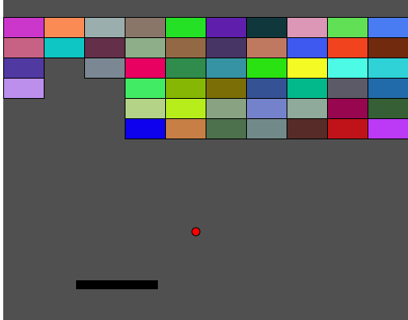



Game Mechanics

Slide 3
Gameplay

Slide 4
Power Up
​increase ball
increase paddle
bom
onzichtbare vloer
dubbele punten
extra leven
gravity ball

Slide 5
Power Down
shrink ball
shrink paddle
black hole
slow down
Ceiling
gehalveerde punten
Invisiball
Invisibrick

Slide 6
Campaign Mode Tech Tree
Telkens moeilijker
Onverwachte veranderingen
Upgrades kopen

Slide 7
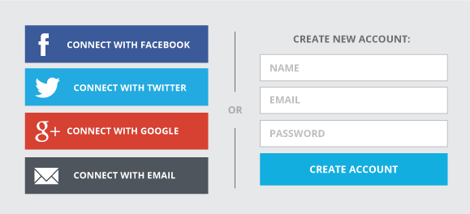

Integration Social Media

Slide 8
Clans
Chat
Gifts
Go to war with a different clan
Bonus for winning a war
…

Slide 9

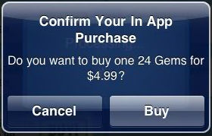
Monetization
Publish to Google Play Store & IOS App Store
In game ads
Microtransactions
Coins
Clans
Etc.

Slide 10
Destribution Performance
Client
IOS and Andriod capable devices
Android 5.0
IOS 10
Windows / MacOS / Linux
Support for ECMASCRIPT 2015
Server
JVM 8
Max response time 200ms

Slide 11
Security
Hacking / Exploiting is prohibited → exclusion from the game
HTTPS protection for sensitive data
Payments can be refunded
Back-up game state, no lost coins/credits
Stability checks
Upgrade server requirements

